Slide 1
How to get published in a Western Journal
Prof. Dr. Malcolm W. Kennedy
Institute of Biomedical and Life Sciences
University of Glasgow
UK - Glasgow, Scottland, G12 8QQ United
Kingdom

Slide 2
Science and discovery in China
Immunisation against smallpox
Moveable type printing
Circumnavigating the world

Slide 3
Science in China
Chinese science in ‘Nature’
Palaeontology
Virus evolution
Food plant genomics
Anthropology – Han migrations

Slide 4
What you are up against …
“The annual National Geographic Survey discovered the sad fact that only 23 out of 56 young A*******s knew the whereabouts of the Pacific Ocean”

Slide 5
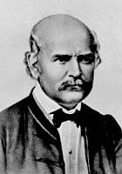
Ignaz Semmelweis (1818 – 1865)
1847 – discovered contagious nature of puerperal fever and use of antiseptic
1850 – lectures on the discovery
1861 – book & polemical response
1865 – nervous breakdown and death

Slide 6
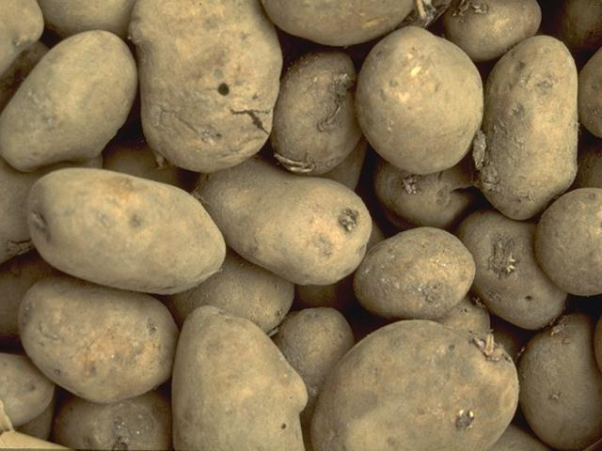
Choosing a journal
Language – does it have to be in English?
Appropriate to your field – does it matter?
Impact factors – who cares?
Who will find my article?

Slide 7
Getting published
First, do good science!
Do something new and interesting
Do something challenging – get noticed!
If you think some (Western?!) ideas are wrong – don’t be afraid to do the experiments to show it!
Design and analyse experiments rigorously
Do the proper controls
Remember, technology is a tool, not science itself

Slide 8
Choosing a journal
Who are your intended audience?
Multidisciplinary journal?
Specialist?
Related field with more widely read journals?
Be safe – but who will read it?
Be brave – you might get lucky, you will learn something, and will make yourself write better.
Balance time expended with the potential reward.

Slide 9
Choosing a journal - Will it be found and read widely?
What institutions will have it in their libraries?
- Paper
- Online
Will electronic databases list it?
- ISI - selective
- Medline, etc.?
- Google

Slide 10

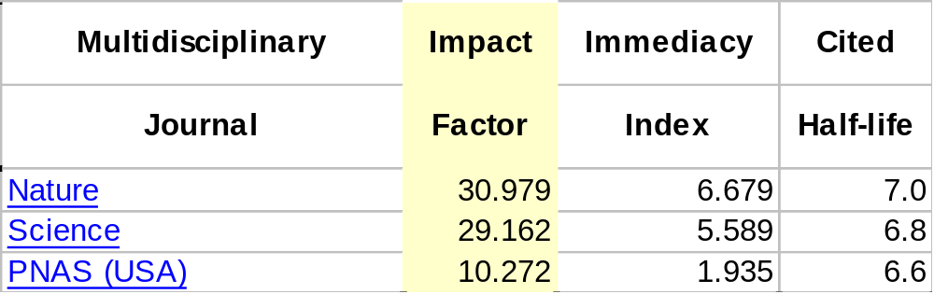
Choosing a journal – impact factors - multidisciplinary
The impact factor is calculated by dividing the number of current citations to articles published in the two previous years by the total number of articles published in the two previous years.
ISI Science Citation Index
Only ~2000 journals selected per year for citation analysis.

Slide 11
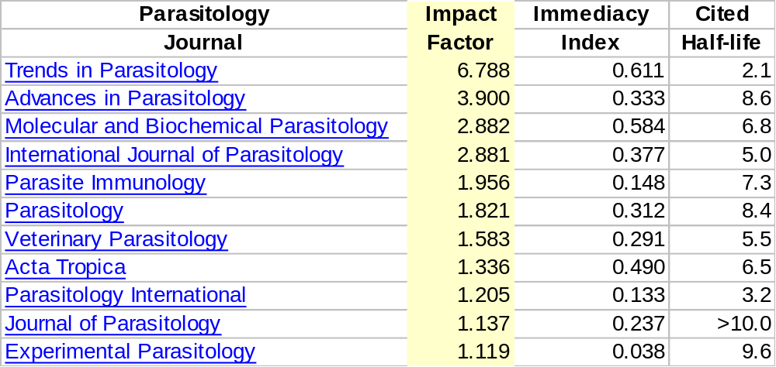
Choosing a journal – impact factors - specialist

Slide 12
Writing the paper
Make yourself familiar with the target journal
Follow the submission guidelines precisely - manuscript format - good quality figures - clear tables - correct reference style and use - electronic submission requirements

Slide 13
Writing the paper – the usual structure
Authorship list The convention – who did the work, who has overall responsibility, who else was involved, who is answerable?
Title Brief and to the point
Summary Clear, concise, informative
Introduction Why is the work important? Background → focus → state importance → hypothesis under test → how tested → summarise achievement
Material and Methods Repeatable by reasonably informed researchers. Sections. Use of references carefully.

Slide 14
Writing the paper – the usual structure
Results Break into sections. Logical flow – explain the reasons for doing the next experiment. Make clear what controls were done.
Discussion Brief statement of achievement → discussion of the implications of the result → speculation (but not too much) and hypothesis → final concluding short paragraph and killer sentence.
Acknowledgements Who else helped? Who provided special facilities? Who paid?
References Correct format. EndNote/Reference Manager
Supporting material – Tables, figures and figure legends
Covering letter

Slide 15
Things that referees and editors love to hate
Language problems.
Not following submission guidelines.
Confusing technology with science.
Repeated or no real advance on previous published work.
Titles, summaries, or abstracts that make no sense or fail to represent the subject matter adequately.
Introductions that give inadequate background or do not say why the paper is worth reading.
Repeating data in tables and figures/graphs.
Reiterating results in Discussion.
References wrongly formatted, incorrect or too old.
Figures and tables without supporting legends or not cited in text.
Seeing the same failings twice – referees mostly wish to help.

Slide 16
Seeking help
For now …
Ask colleagues (first language or fluent) to pre-review.
Ask someone younger!
Create a writing and checking team.
Ask your institute to employ a writer-helper.
Make friends abroad who will help correct manuscripts.
For the future – the next generation …
Scientific writing in English courses in undergraduate degrees.
Dissertations and (some?) examinations in English.
Lectures (some?) and tutorials in English.
English speaking guest lecturers and tutors

Slide 17
Good luck!

